Slide 1
Citing in APA (7th ed) Format
Kevin Tanner - kevin.tanner@sait.ca

Slide 2
Why do we cite?
To help your reader (your instructor) identify and locate the source that you used
Different sources have different required components, and not every source will have every component
To provide evidence that your assignment/position is well-researched
Your reader will judge you if your research is bad
To give credit to the author of ideas which are not your own, and thereby avoid plagiarism
It’s okay to use others ideas and words as support or evidence, as long as you appropriately attribute them using citations

Slide 3
Why are we using APA* style?
One of the more commonly used citation styles
Easy(ish) to use
Because we said so!!!
*APA = American Psychological Association

Slide 4
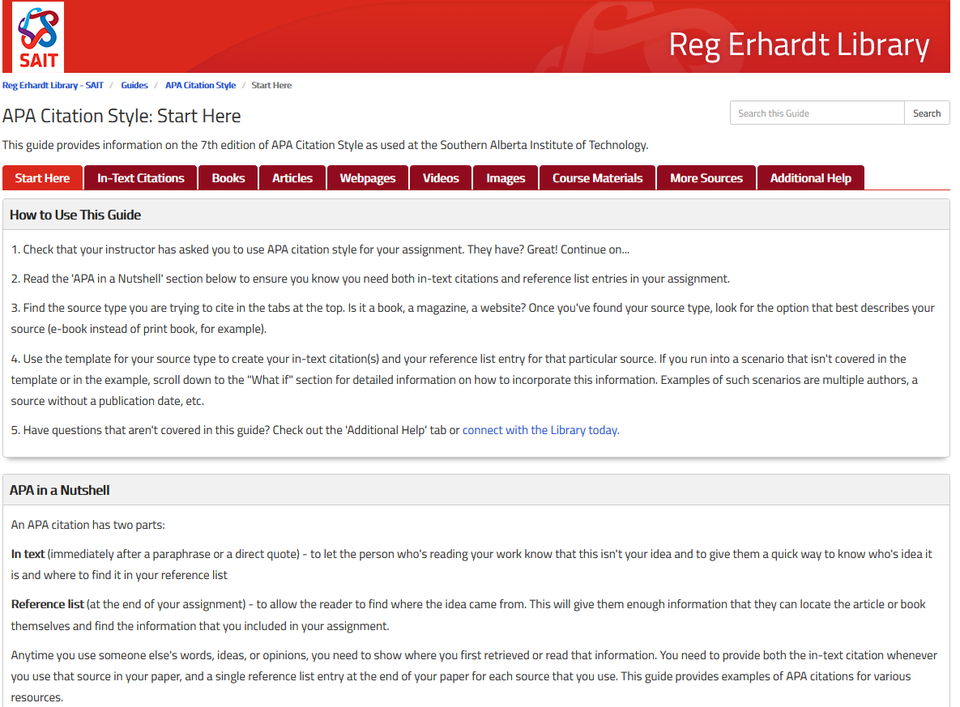
APA Guide – http://libguides.sait.ca/apa

Slide 5
Two parts to an APA citation
In-text citation
Reference list entry
Anytime you use someone else’s words, ideas, or opinions, you must cite it. You can paraphrase (put in your words) or directly quote (copy it word-for-word and place quotation marks around it) from a source, you must cite it.
To properly cite a source, there must be an in-text citation wherever it is used in your assignment and a reference list entry at the end of your assignment.

Slide 6
Two parts to an APA citation
This is the most common way of providing an in-text citation (Doe, 2019).
Doe (2019) provides several examples of in-text citations.
“There are many ways to do in-text citations, like direct quoting” (Doe, 2019).
You can direct quote as Doe (2019) suggests, but you can also paraphrase.
References
Doe, J. (2019). Example of a reference list citation. Retrieved
July 1, 2020, from http://sait.ca/library

Slide 7
Example Citation – Article
Author Surname, First Initial. Second Initial. (Year). Article title: Subtitle. Periodical Title, Volume(issue), page range.
NOTE: Capitalization, italicization, and punctuation all matter

Slide 8
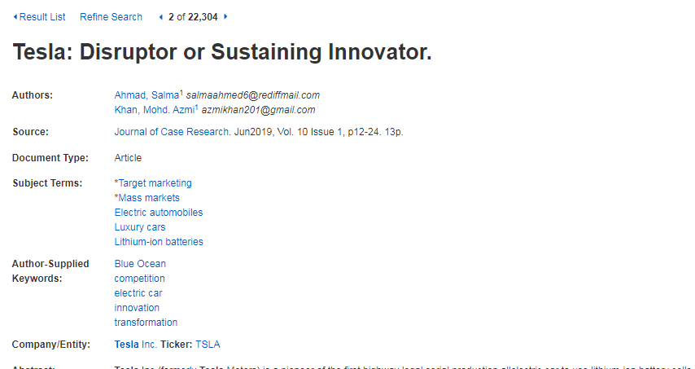
Author Surname, First Initial. Second Initial. (Year). Article title: Subtitle. Periodical Title, Volume(issue), page range.
(Last name(s), year)

Slide 9
Author Surname, First Initial. Second Initial. (Year). Article title: Subtitle. Periodical Title, Volume(issue), page range.
(Last name(s), year)

Slide 10
Author Surname, First Initial. Second Initial. (Year). Article title: Subtitle. Periodical Title, Volume(issue), page range.
(Last name(s), year)

Slide 11
Author Surname, First Initial. Second Initial. (Year). Article title: Subtitle. Periodical Title, Volume(issue), page range.
(Last name(s), year)

Slide 12
Month and day are typically only required for newspapers/magazines – things that are published monthly, weekly, daily.
Tip = no volume? You probably need at least the month in addition to the year
Author Surname, First Initial. Second Initial. (Year). Article title: Subtitle. Periodical Title, Volume(issue), page range.
(Last name(s), year)

Slide 13
Author Surname, First Initial. Second Initial. (Year). Article title: Subtitle. Periodical Title, Volume(issue), page range.
(Last name(s), year)

Slide 14
Pay close attention to capitalization, punctuation, and formatting.
Note how volume and issue are written in the citation
Note how the article title is in sentence case but the periodical title is in title case and italicized
Note how the letter ‘p’ is taken out of the page range
Ahmad, S. & Khan, M. A. (2019). Tesla: Disruptor or sustaining innovator. Journal of Case Research, 10(1), 12-24.
(Ahmad & Khan, 2019)
Ahmad and Khan (2019)

Slide 15
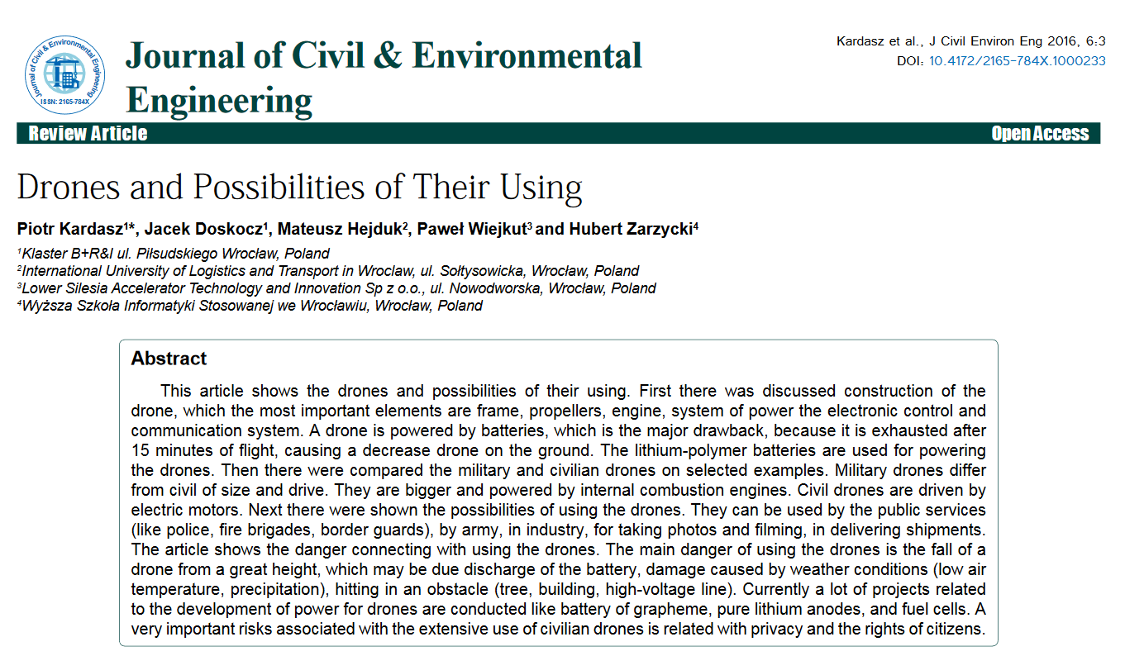
Author Surname, First Initial. Second Initial. (Year). Article title: Subtitle. Periodical Title, Volume(issue), page range.
(Last name(s), year)

Slide 16
No page range available, but add doi at the end, listed in the top right. Lowercase the letters “doi” in your citation
See example below
Kardasz, P., Doskocz, J., Hejduk, M., Wiejkut, P., & Zarzycki, H. (2016). Drones and possibilities of their using. Journal of Civil & Environmental Engineering, 6(1). http://dx.doi.org/10.4172/2165-784X.1000233
(Kardasz et al., 2016)

Slide 17
Example Citation – Webpage
Personal or Corporate Author. (creation date). Title of webpage. Retrieved from URL.
NOTE: Include date in “Retrieved from” statement if website may be updated in the future
NOTE: Never use the copyright date as the “creation date”. If no date can be found, list n.d. in place of the date

Slide 18
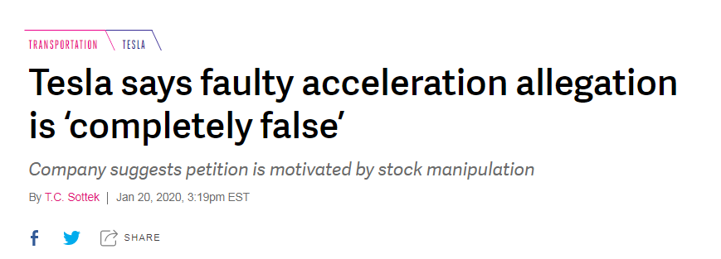
Personal or Corporate Author. (creation date). Title of webpage. Retrieved from URL.
(Last name(s), year)

Slide 19
Sottek, T.C. (2020, January 20). Tesla says faulty acceleration allegation is ‘completely false’. Retrieved January 22, 2020, from https://www.theverge.com/2020/1/20/21074318/tesla-says-faulty-acceleration-allegation-is-completely-false
(Sottek, 2020)
Sottek (2020)

Slide 20
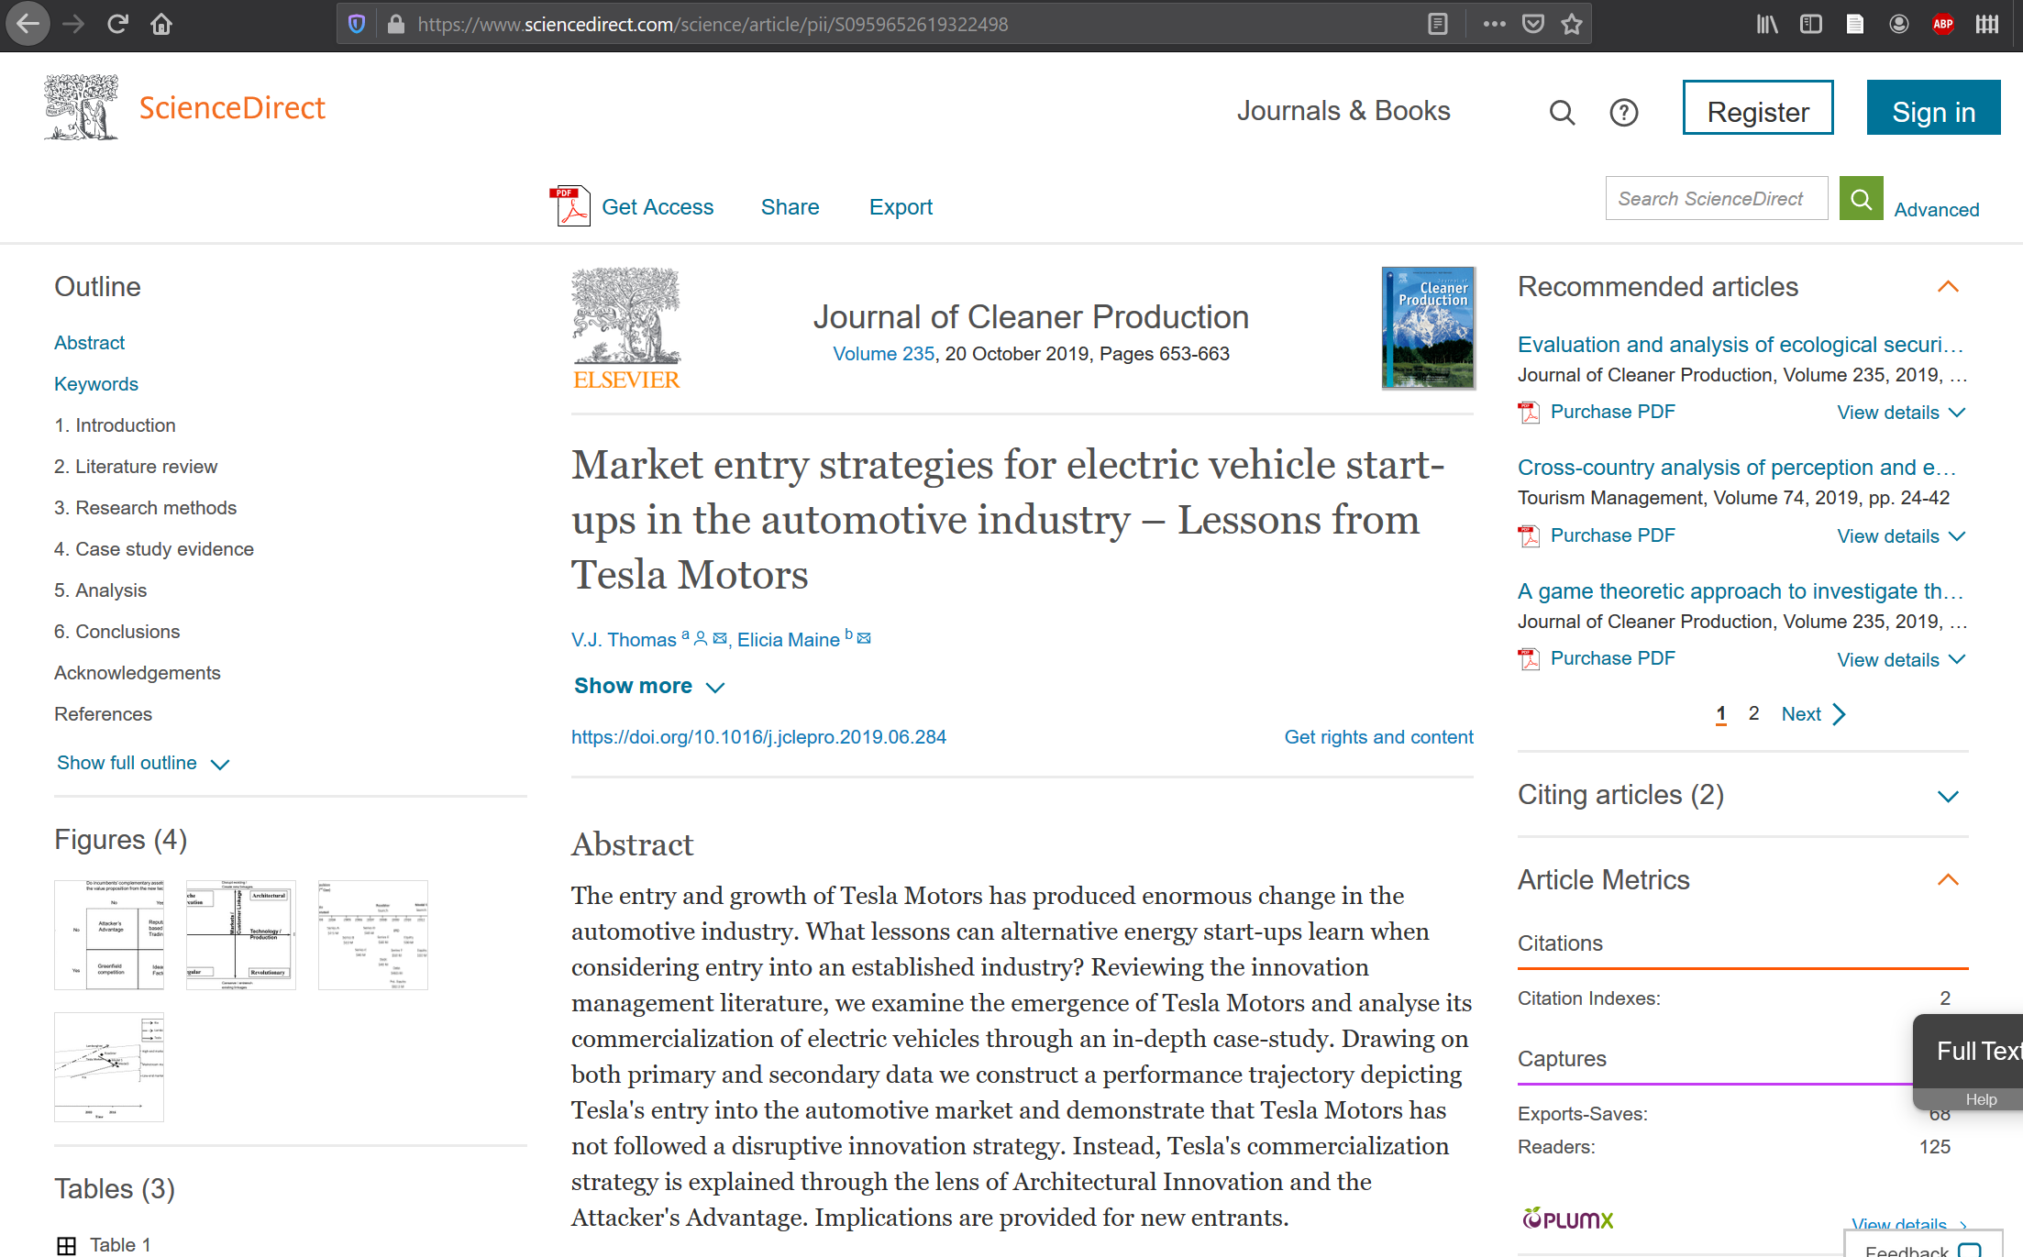
What kind of source is this?

Slide 21
What are the problems with this citation?
ELIZABETH WEST (no date). Steve Sitto: Tesla senior Manager of global travel, meetings & mobility. Business Travel News, volume 36, issue 13. page 15-16.

Slide 22
What are the problems with this citation?
ELIZABETH WEST (no date). Steve Sitto: Tesla senior Manager of global travel, meetings & mobility. Business Travel News, volume 36, issue 13. page 15-16.
West, E. (2019). Steve Sitto: Tesla Senior Manager of Global Travel, Meetings & Mobility. Business Travel News, 36(13), 15–16.
1. author 2. year 3. capitalization of article title 4. italicization of periodical title 5. incorrect volume and issue formatting 6. incorrect page range formatting

Slide 23
FAQ
Can I use the Word reference manager?
You can but I really recommend against it. It’s not accurate most of the time, and if you put incorrect info in it will spit incorrect info out. You should learn how to do this from scratch before you rely on it. Also, Zotero or Mendeley are much better
Can I use an online generator?
Again, it is your life to live. They are more accurate than Word, but see above and learn how the style works first
What do I do if I have an exception?
Check the homepage of the APA Guide or OWL Purdue – if you’re still not sure, ask us

Slide 24
Research Skills Assignment
Find and evaluate one source from the LIBRARY (must be from Library)
Due at the deadline posted on Brightspace
Questions? Let me know!
Kevin.tanner@sait.ca

